Slide 1
Machine Learning Applications for Offshore Wind Farms
Austin Hancock

Slide 2
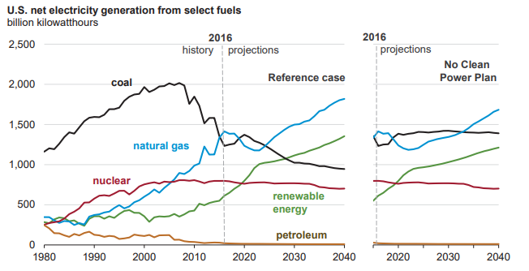
Offshore Wind Farms
Importance of offshore wind
Electricity
Declining costs
Regulations

Slide 3
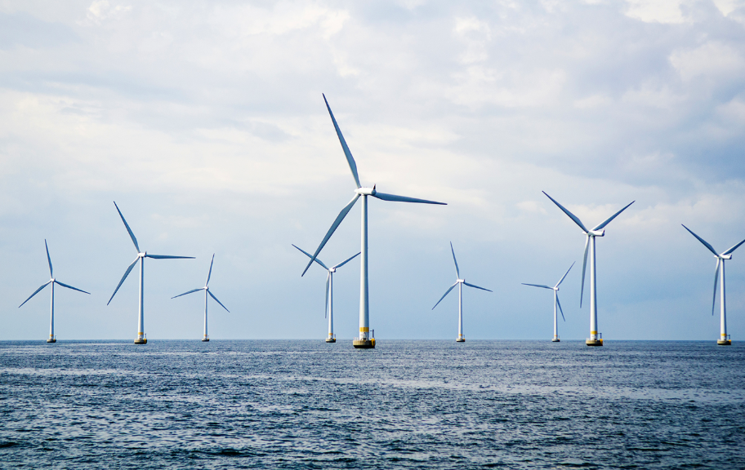
Offshore Wind Farms
Importance of offshore wind
Electricity
Declining costs
Regulations
Offshore vs. Onshore
Up and coming
Wind Predictability
Land Usage

Slide 4
Offshore Wind Farms
Importance of offshore wind
Electricity
Declining costs
Regulations
Offshore vs. Onshore
Up and coming
Wind Predictability
Land Usage
Predict
Power output

Slide 5
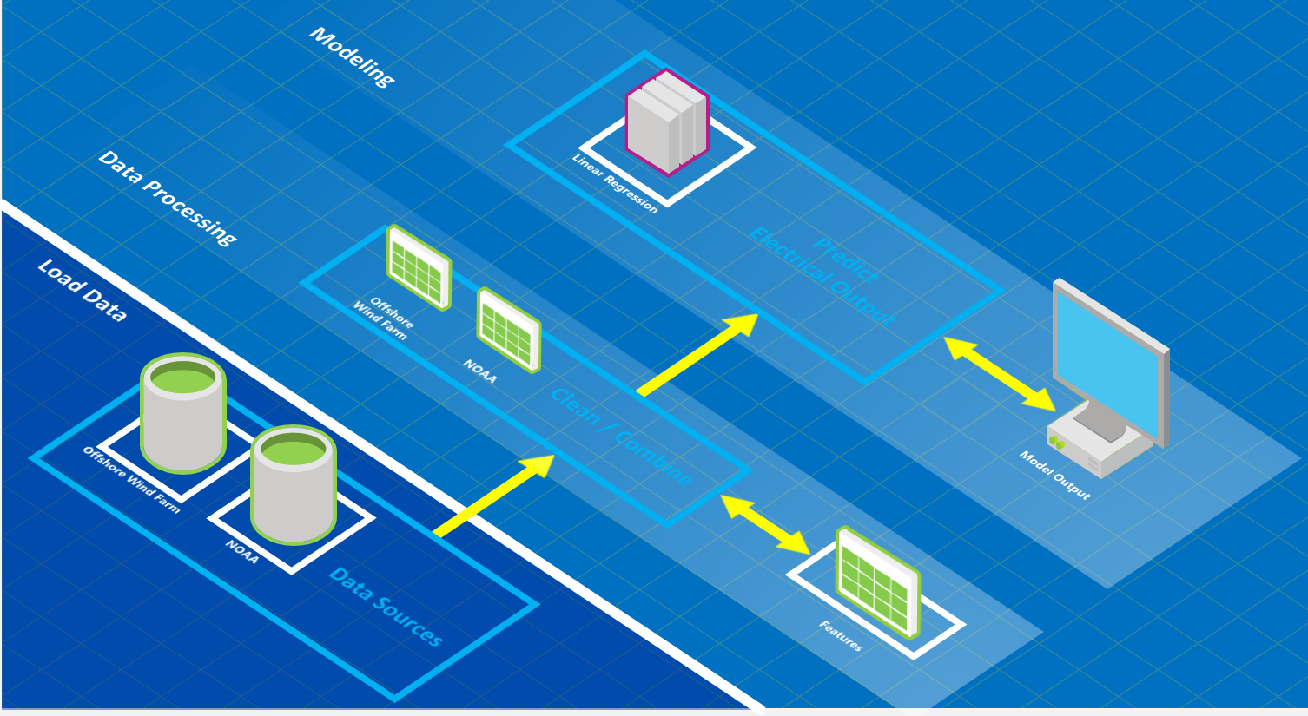
Workflow

Slide 6
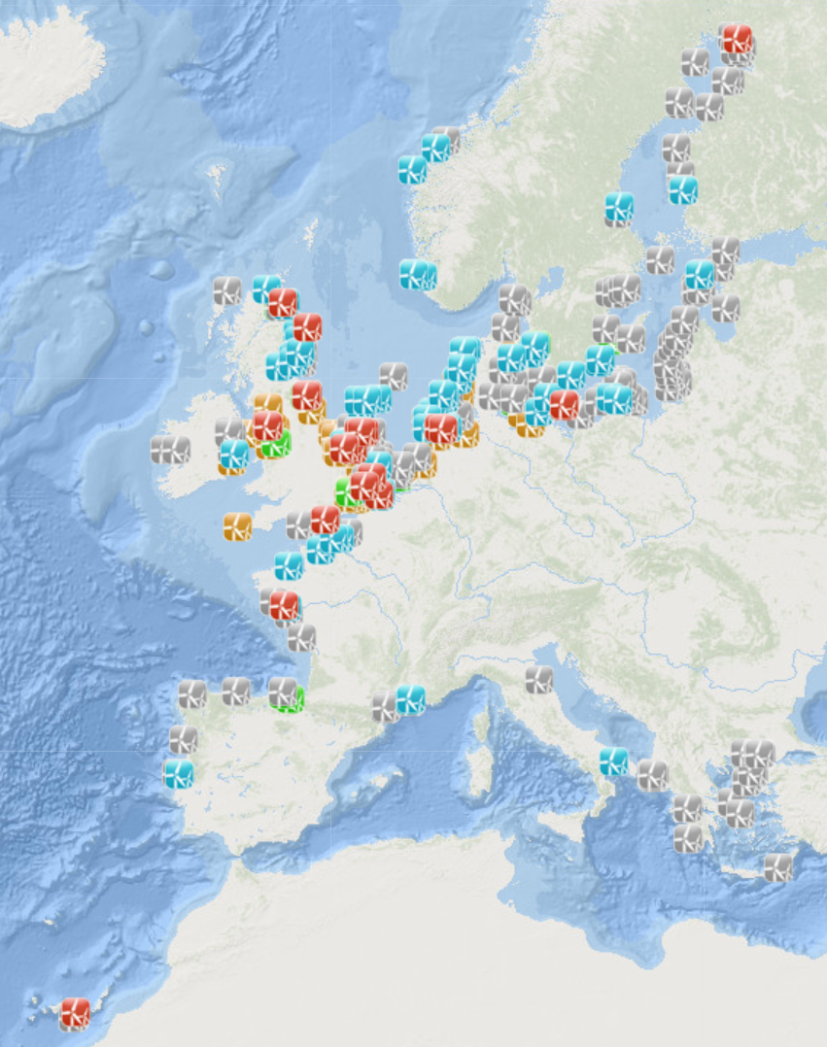
Data Sources
TheWindPower.net
25 variables
724 observations

Slide 7
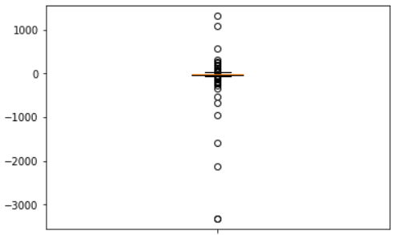
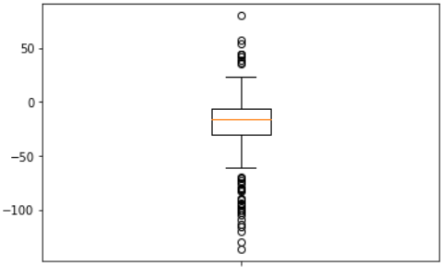
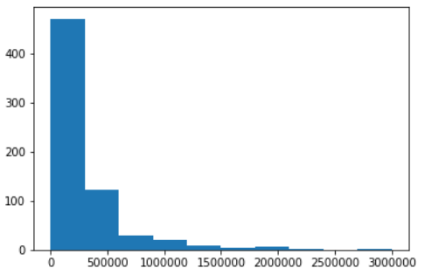
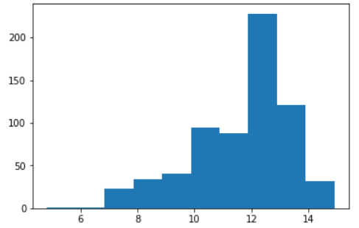
Data Preparation
Steps
Outlier detection
Data transformation
Feature extraction
Fill missing values….

Slide 8
Data Preparation
Real world, real problems
Inaccurate locations
Missing hub height

Slide 9
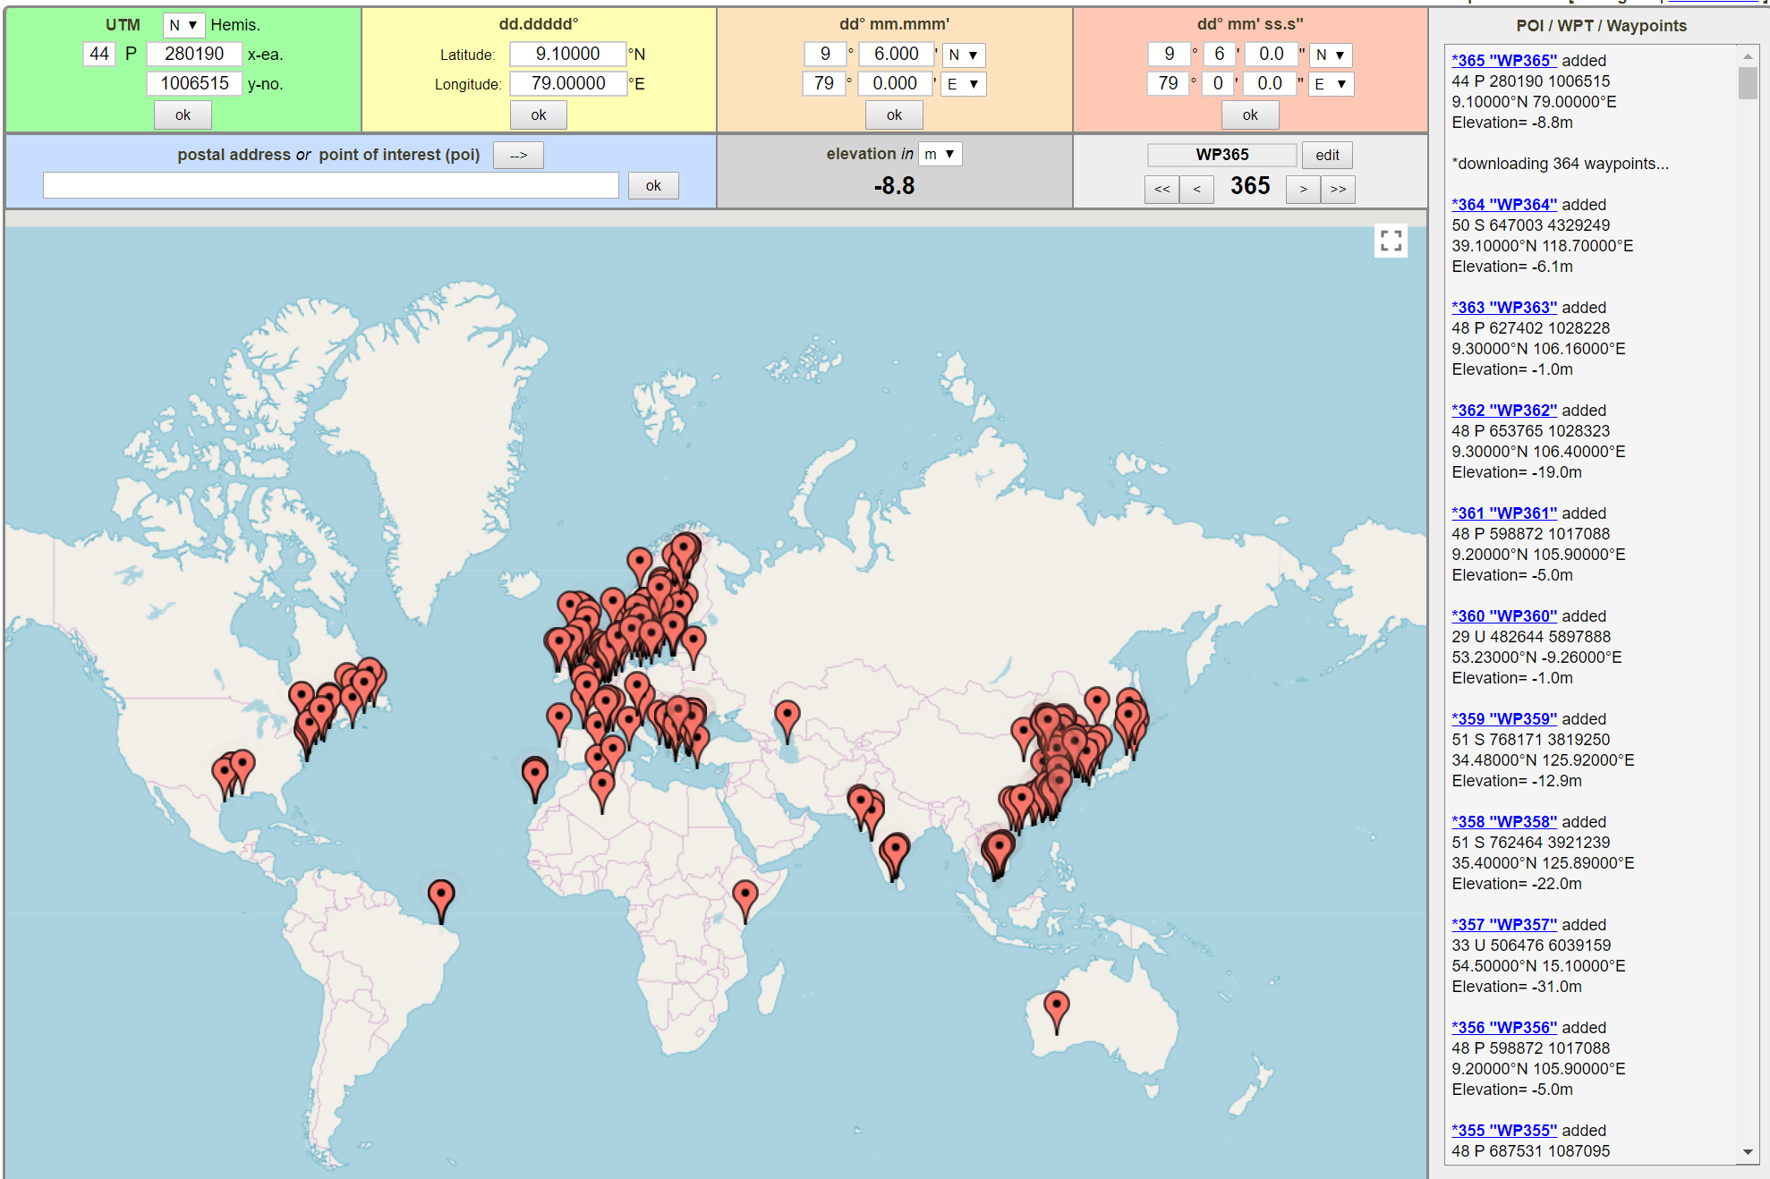
Data Preparation
Real world, real problems
Inaccurate locations
Missing hub height
Geoplaner
Lat/lon
Depth (m)

Slide 10
Data Preparation
Real world, real problems
Inaccurate locations
Missing hub height
Geoplaner
Lat/lon
Depth (m)
Inputs
Original
25 variables
724 wind farms
Final
123 variables
640 wind farms

Slide 11
Models (python)
Linear Regression / Kmeans Clustering
Random Forest
K-Nearest Neighbors
Neural Network
Majority Vote Ensemble

Slide 12
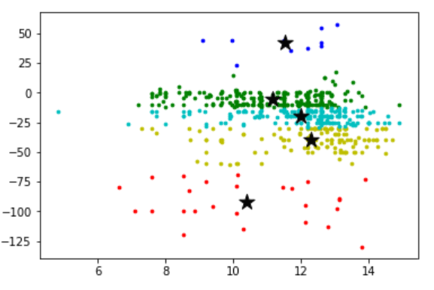
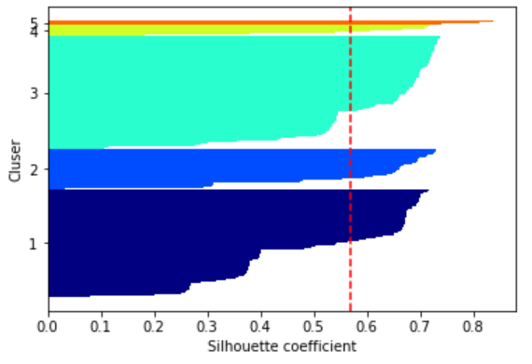
Kmeans Clustering
Determine Clusters
LinearRegression()
KMeans()

Slide 13
Predict Power Output
Wind Farms
1 – 200 turbines
Output per turbines = Power output (kW) / # Turbines

Slide 14
Predict Power Output
Wind Farms
1 – 200 turbines
Output per turbines = Power output (kW) / # Turbines
Output per turbine classes
< 7.4
7.4 – 20
20.1 – 54.6
54.7 – 148.4
> 148.4

Slide 15
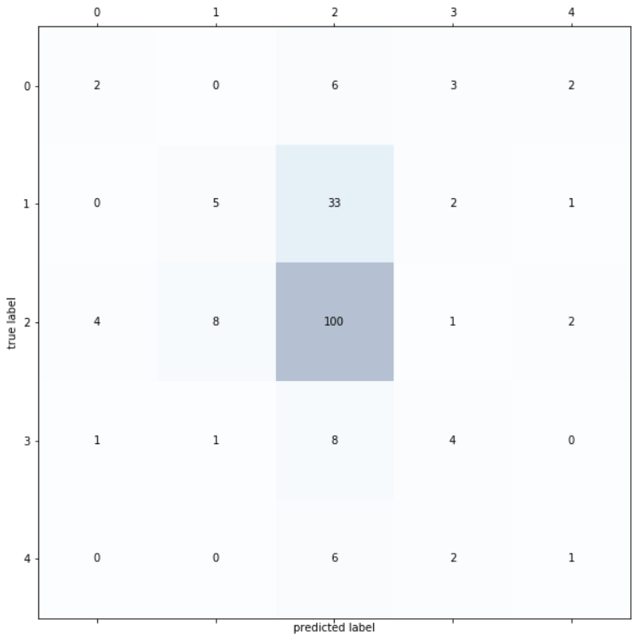
Random Forest
Random Forest
Sklearn.RandomForestClassifier()
Train: 448 obs
Test: 192 obs
Trees: 100
Misclassified samples: 80
Accuracy: 58 %

Slide 16
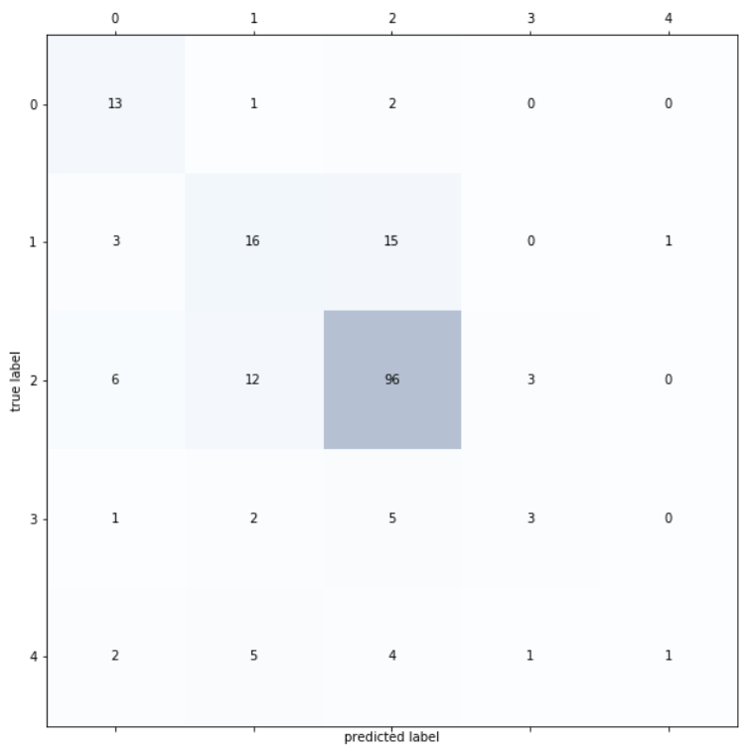
K-Nearest Neighbors
KNN
Sklearn.KNeighborsClassifier()
Train: 448 obs
Test: 192 obs
# neighbors: 5
Misclassified samples: 63
Accuracy: 67 %

Slide 17
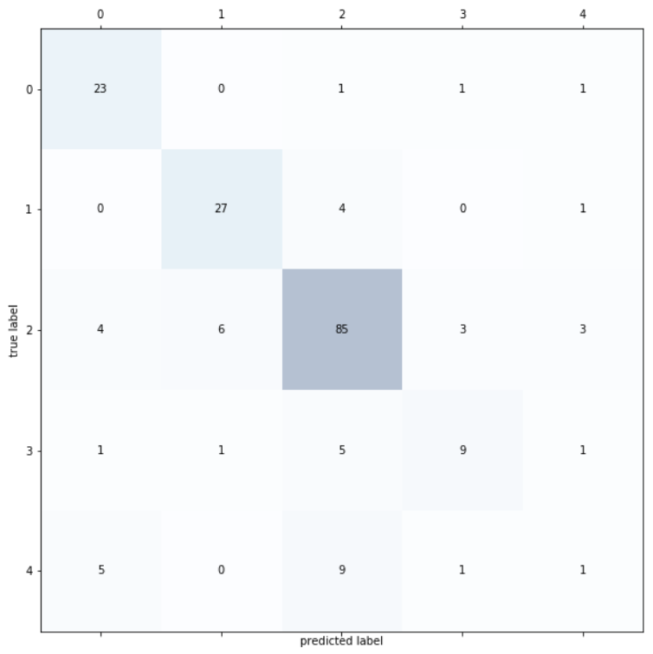
Neural Network
Single-layer Perceptron
Sklearn.Perceptron()
Train: 448 obs
Test: 192 obs
Epochs: 40
Misclassified samples: 47
Accuracy: 76 %

Slide 18
Ensemble Method
Binary split
Power output > 33 kW/turbine
343
Power output <= 33 kW/turbine
297

Slide 19
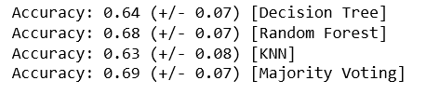
Majority Vote
Majority Vote Classifier
Classifiers
Decision Tree
Random Forest
KNN
Output:

Slide 20
Results
Multi-class
Binary – Ensemble
Model | Accuracy Score
Random Forest | 58 %
KNN | 67 %
Neural Network | 76 %
Model | Accuracy Score
Decision Tree | 64 %
Random Forest | 68 %
KNN | 63 %
Majority Vote | 69 %

Slide 21
Future Work
Filling missing data
Location accuracy
Additional datasets

